Slide 1
Russia’s Syrian Campaign
& General Gerasimov
Foreign Military Studies Office
Fort Leavenworth, Kansas
Chuck Bartles
charles.k.bartles.civ@mail.mil

Slide 2
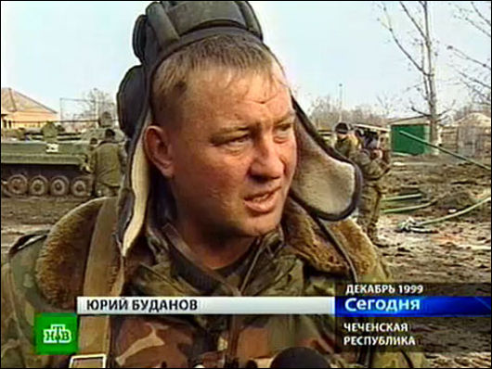
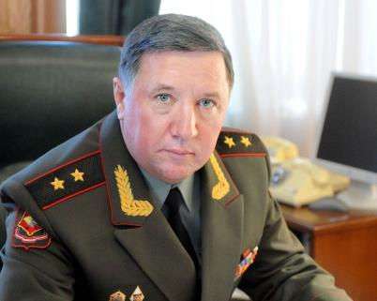
Ethics in the Russian Armed Forces
Morally right vs. legally right
The ends always justify the
means in regard to the
survival of the state
No “1-strike” policies, will accept risk
Well suited for the “Grey Zone”
General Gerasimov:
  Two very different examples
Colonel Yuri Budanov
Former 160th Tank Regiment Commander
Colonel General Vladimir Chirkin
Former Ground Forces Commander-in-Chief
Notes:
Ethics in the Russian Armed Forces
Stomping out military corruption has been a top priority of the Russian civilian and military leadership for quite some time. Due to the Russian Federation’s Tsarist/Soviet past, Russia, and by inheritance the Russian military, has developed a nuanced view towards corruption, which makes its eradication difficult. Crimes of theft against individuals are viewed the same as in the West, but crimes of theft against the state are seen as much more tolerable, although they are seen as somewhat tolerable, they are still embarrassing. The most recent high profile military corruption fiasco has involved the recent conviction and sentencing of Colonel General Vladimir Chirkin, the former Ground Troops Commander-in-Chief. Although there have been other high profile gaffes, such as Airborne Troops Commander-in-Chief Colonel General Shamanov dispatching an airborne unit to interfere in the prosecutorial investigation of a family member, the Chirkin case has garnered substantial interest, as it is unusual for such a high-ranking and prominent official to be tried, convicted, and sentenced. One of the most interesting aspects of the case is the involvement of the Chief of the Russian General Staff , General Valeri Gerasimov. General Gerasimov is an adamant supporter of General Chirkin and asked that Chirkin either be found not guilty or, if found guilty, that he be given no prison time. In the Russian system, personal connections and loyalties often trump institutional governance, and this appears to be such a case. It is important to note that these views towards “relaxed morals” are not reserved solely for senior leaders, as the Russian military justice system is now being amended to allow some crimes that once required dismissal from service to now allow lesser punishments. There appears to be concern that the previous regulation was weeding out too many good officers who had a few peccadilloes. In the Russian view, it is far better to have an army with the best and brightest, albeit ethically challenged, than an army of the ethical, but less capable. Undoubtedly, as Russia continues experimenting with undeclared wars and indirect and asymmetric methods there is a need for officers who can operate in the grey area that results when what needs to be done conflicts with the letter of the law.
Perhaps the reason that the Russian military is having difficulty dealing with the corruption is the view that Russia, and most Russians, have regarding the relationship between what is legally and morally right. These two concepts are very different in the West, but in Russia, whatever is considered “morally right” is usually interpreted to be “legally right.” This can be seen in state asset seizures of wealthy oligarchs’ property, the annexation of the Crimea, and the conduct of an undeclared war Eastern Ukraine (in order to destabilize the Ukrainian government, a government which Russia perceives to be illegitimate and installed by the U.S.). This tendency to interpret morally right as legally right make the Russian Armed Forces, intelligence, and security services well suited to operating in the ambiguous “Grey Zone” that many operations are and will occur, but this way of thinking is certainly making the eradication of corruption difficult, as subordinates see their superiors growing wealthy from graft, and decide that it is only right to take a little for one’s self.
Chechnya experience
Gen Gerasimov was born in the city of Kazan, on the Volga River and capital of the ethnic Tatars.
He began his military career in 1977 with the Northern Group of Forces. After serving in the Far Eastern and Baltic Military Districts, he became chief of staff of the 58th Army in the North Caucasus Military District in 1999, shortly before the second Chechen war erupted. During his time in Chechnya, he was personally involved in the arrest of Yury Budanov, an army colonel later convicted for the murder of a Chechen girl. That led journalist Anna Politkovskaya, a vocal critic of the Chechen conflict who was murdered in 2006, to describe him as "a man who was able to preserve an officer's honour" during the war.
Russian troops fighting near Grozny, 30 Jan 2000. In 2001, at the height of the Chechen conflict, Gen Gerasimov was appointed commander of the 58th Army.

Slide 3
Gerasimov’s Article: in Context
Role of the General Staff: force structure design, and operational art (not strategy)
The Value of Science Is in the Foresight: New Challenges Demand Rethinking the Forms and Methods of Carrying out Combat Operations (February 2013)
The Academy of Military Science
Nothing ‘new’ in the theory, common thinking in Russia security elite
Real intended audience? Domestic leadership, not foreign (speculative)

Slide 4
Gerasimov’s Article: Outline
Explains Arab Spring & Color Revolutions are the new ways how wars are fought
War shifts from primarily military to nonmilitary methods (DIME- 4:1)
Info operations, social media, private military companies, robotics, no-fly zone, naval blockades, SOF, Prompt Global Strike, Antiballistic Missile Defense
So what is he talking about?

Slide 5
Gerasimov’s Article: What is Overlooked?
“It is necessary to recognize, that if we understand the essence of traditional military operations, which regular Armed Forces carry out, then our knowledge of asymmetric forms and methods is superficial. In connection with this the role of military sciences, which must create an integral theory of similar actions, is growing. The works and research of the Academy of Military Sciences could help in this…Economic questions flow from this: what is modern war, for which it is necessary to prepare the army, and for which it must be armed? Only having answered this, can we determine the direction of the force-generation and development of the Armed Forces in the long-term perspective. For this is it necessary to imagine precisely, what forms and methods of their use will be utilized...”

Slide 6
Gerasimov’s Article: The Theory
Decision is made to enact regime change
Information Operations (mass media CNN/BBC, NGOs, social media, etc.) used to rile the population and/or disaffected minorities
Antigovernment actions require strong government response, creating conditions for economic & diplomatic sanctions
SOF, Private Military Companies, or any other available forces are introduced to the conflict to create conditions requiring more aggressive government response creating a pretext for no-fly zones, blockades, and direct military action
Government is toppled
No requirement for all aspects, or any particular order
Notes:
The Russian playbook (arguably) for force projection in the Russkiy Mir has involved a fullcourt
press of the elements of national power, beginning with economic pressure and intense
information operations to shape domestic and foreign perceptions. As the information operation
campaign ramps up, ethnic Russian separatists, or any other groups in the region with antigovernment
leanings and pro-Russian sympathies, will be exploited and primed for action. A
population of ethnic separatists (either ethnic Russians or those favorably disposed toward
Russia) is a key component for facilitating the introduction of follow-on forces, such as
Cossacks, volunteers from Russia, private security companies, and undeclared military forces,
into the conflict by providing legitimacy as protectors of the aggrieved separatists.

Slide 7
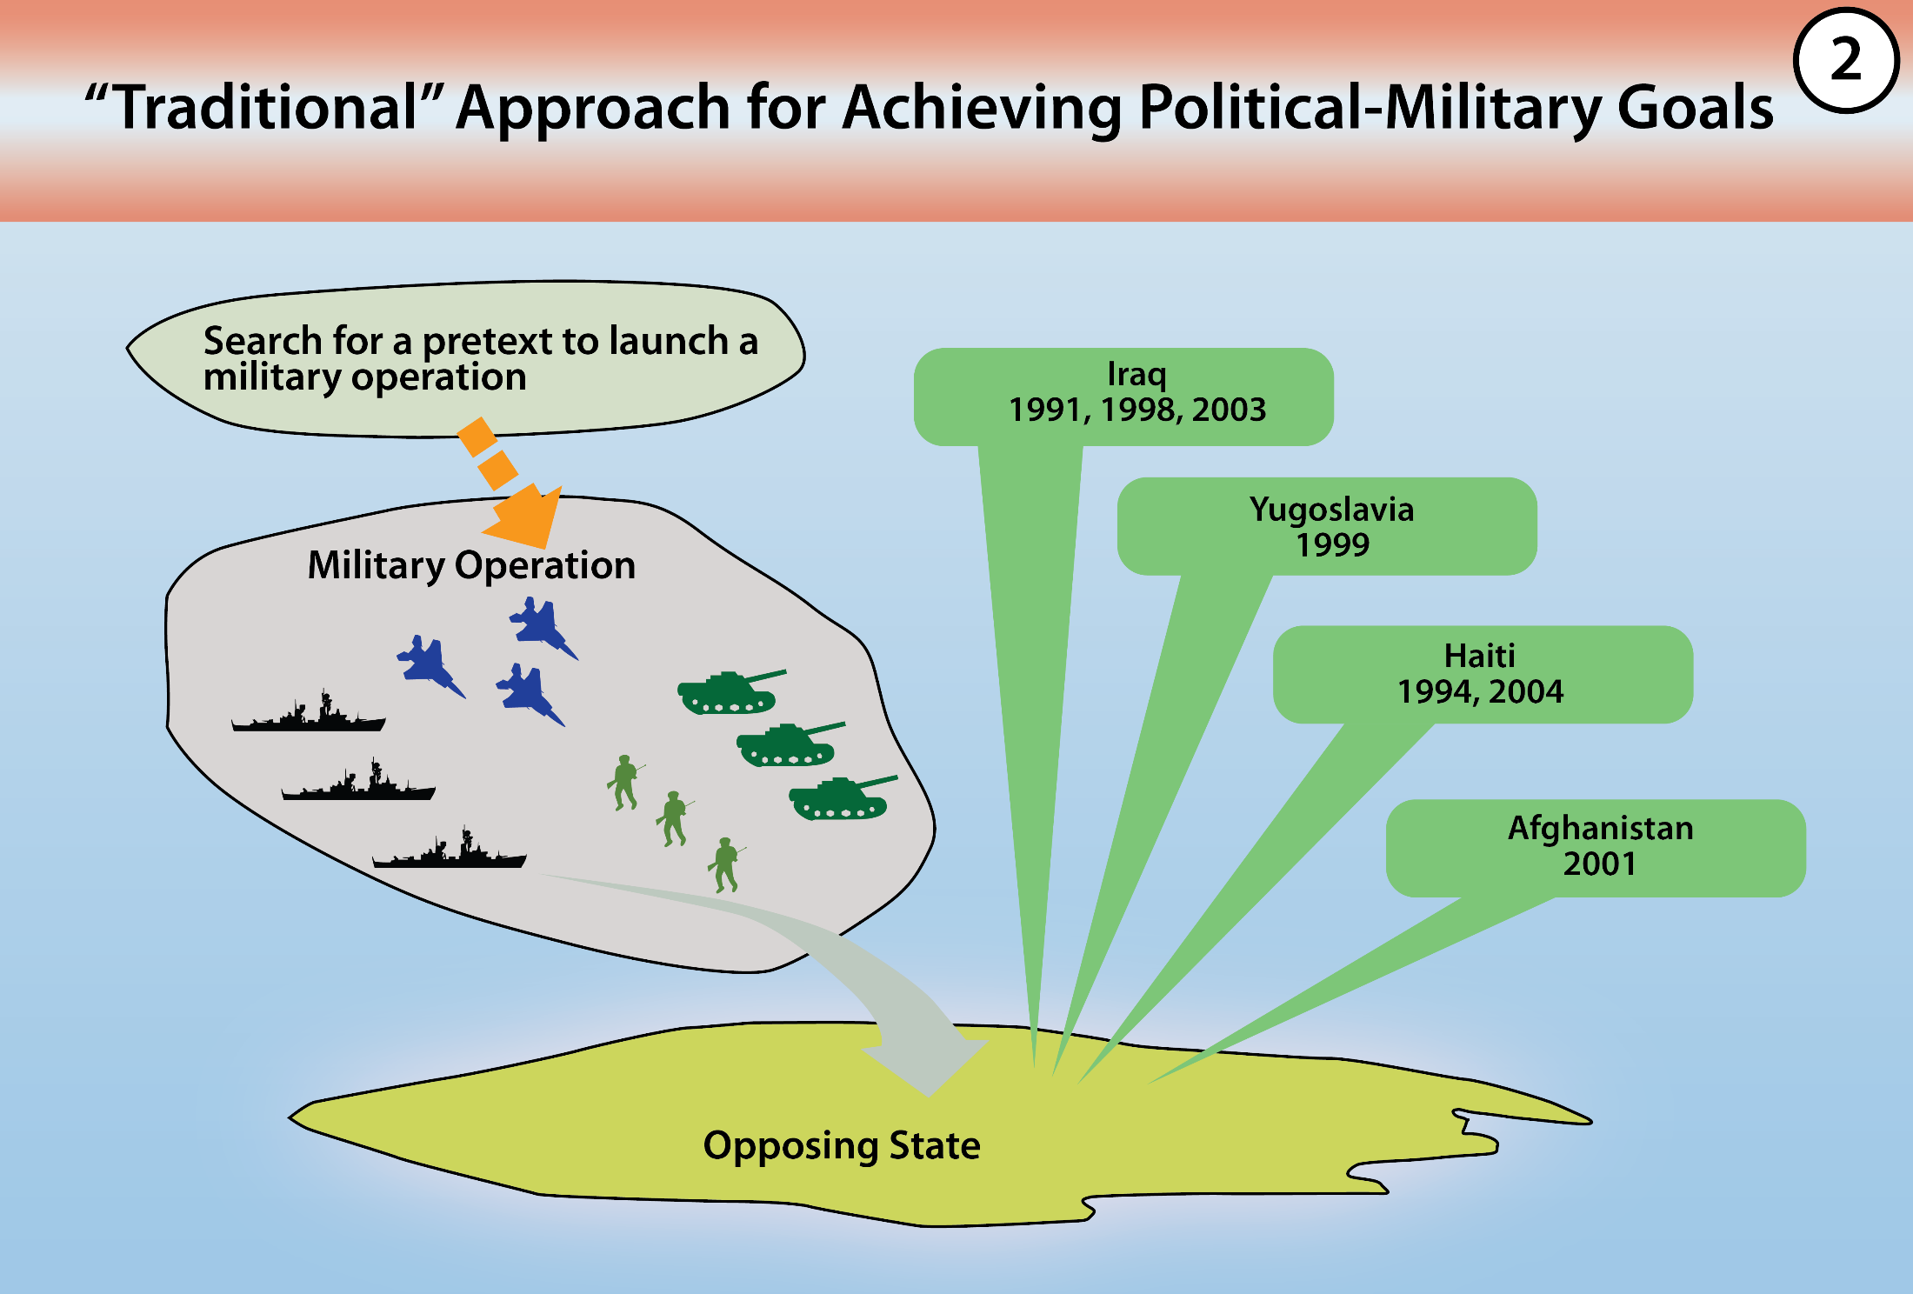
Notes:
Dr. Anthony H. Cordesman attended the Russian Ministry of Defense’s third Moscow Conference on International Security on 23 May 2014. While in attendance, Cordesman was able to take pictures of Gen. Valery Gerasimov’s slide presentation. A few of the presentation’s key slides (figures 1, 2, and 3) have been substantially recreated to accompany this article. Cordesman later produced a report on the conference that includes a broader selection of not only the slides presented by Gerasimov, but a selection of materials presented by other participants. The report is titled “A Russian Military View of a World Destabilized by the US and the West.” It may be viewed in its entirety at the Center for Strategic & International Studies website, accessed 20 November 2015, http://csis.org/publication/russia-and-color-revolution.

Slide 8
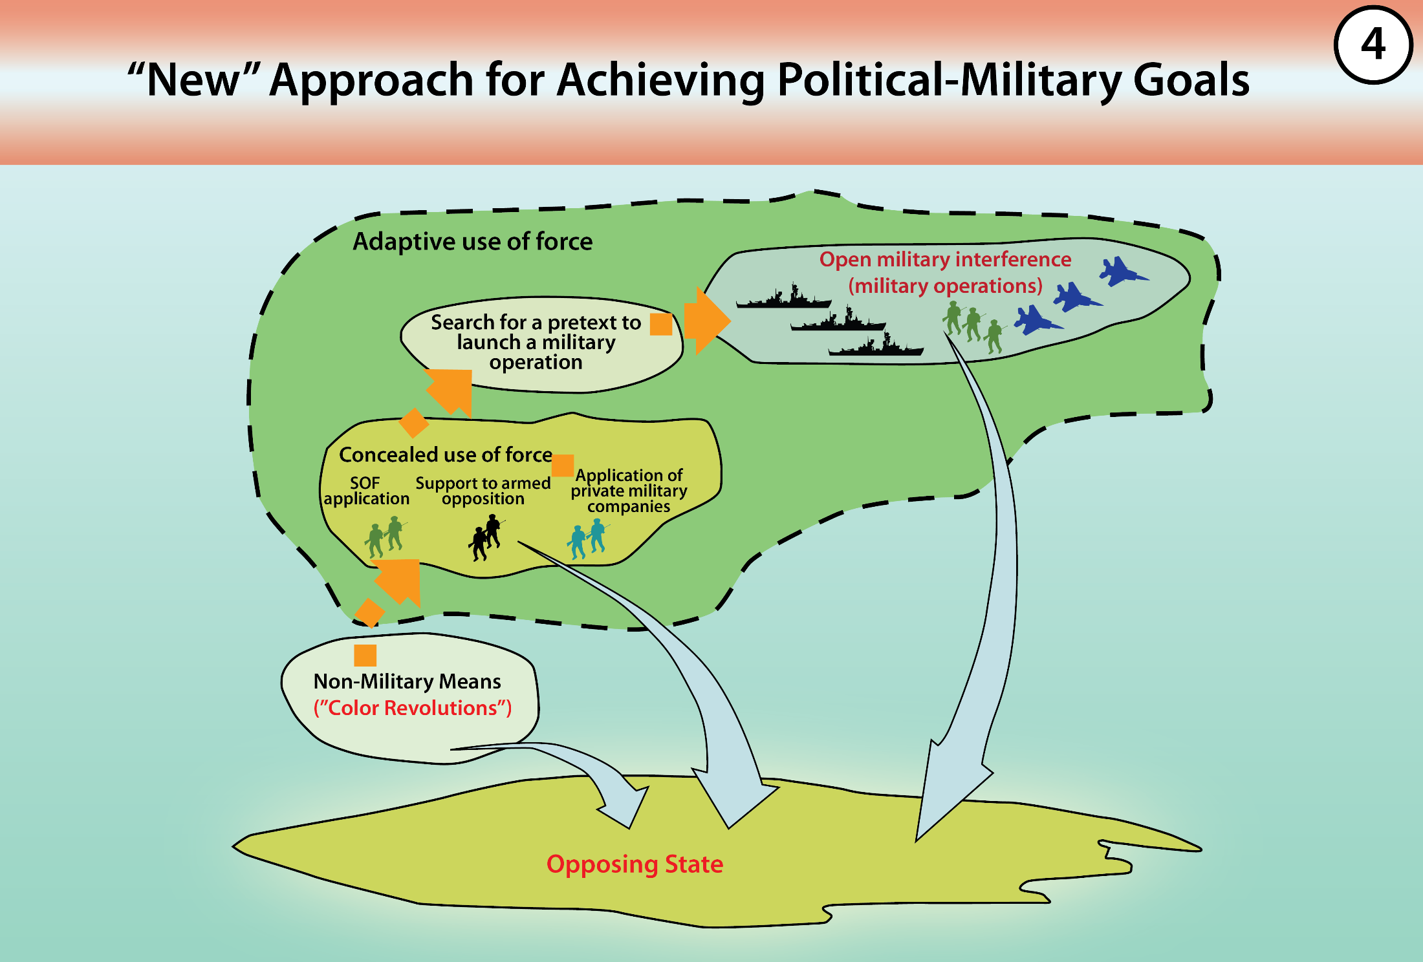
Notes:
Dr. Anthony H. Cordesman attended the Russian Ministry of Defense’s third Moscow Conference on International Security on 23 May 2014. While in attendance, Cordesman was able to take pictures of Gen. Valery Gerasimov’s slide presentation. A few of the presentation’s key slides (figures 1, 2, and 3) have been substantially recreated to accompany this article. Cordesman later produced a report on the conference that includes a broader selection of not only the slides presented by Gerasimov, but a selection of materials presented by other participants. The report is titled “A Russian Military View of a World Destabilized by the US and the West.” It may be viewed in its entirety at the Center for Strategic & International Studies website, accessed 20 November 2015, http://csis.org/publication/russia-and-color-revolution.

Slide 9
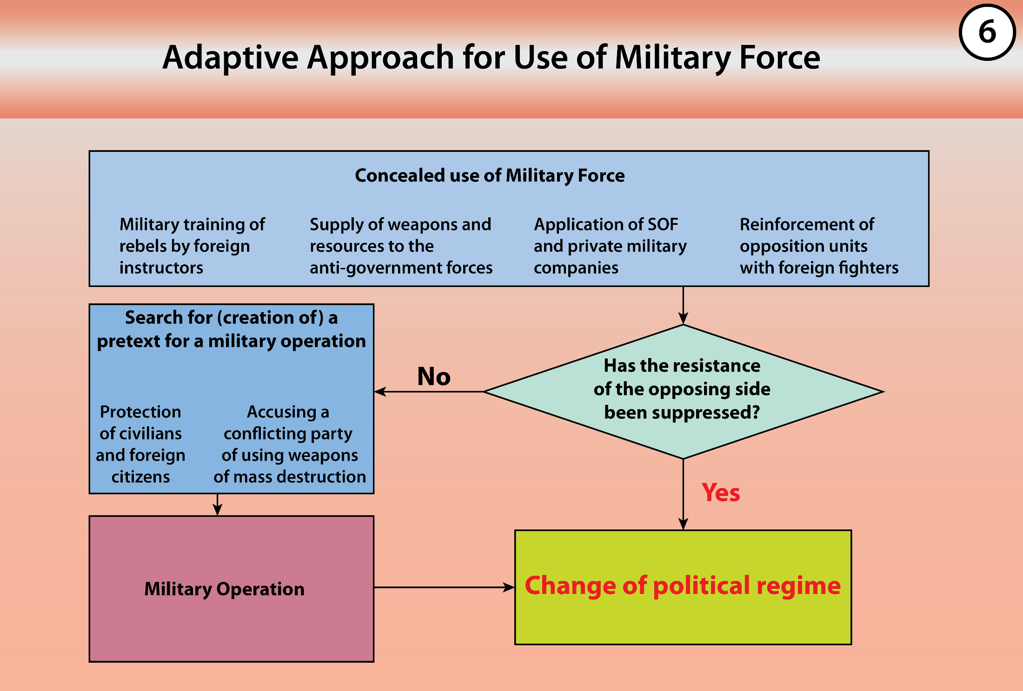
Notes:
Dr. Anthony H. Cordesman attended the Russian Ministry of Defense’s third Moscow Conference on International Security on 23 May 2014. While in attendance, Cordesman was able to take pictures of Gen. Valery Gerasimov’s slide presentation. A few of the presentation’s key slides (figures 1, 2, and 3) have been substantially recreated to accompany this article. Cordesman later produced a report on the conference that includes a broader selection of not only the slides presented by Gerasimov, but a selection of materials presented by other participants. The report is titled “A Russian Military View of a World Destabilized by the US and the West.” It may be viewed in its entirety at the Center for Strategic & International Studies website, accessed 20 November 2015, http://csis.org/publication/russia-and-color-revolution.

Slide 10
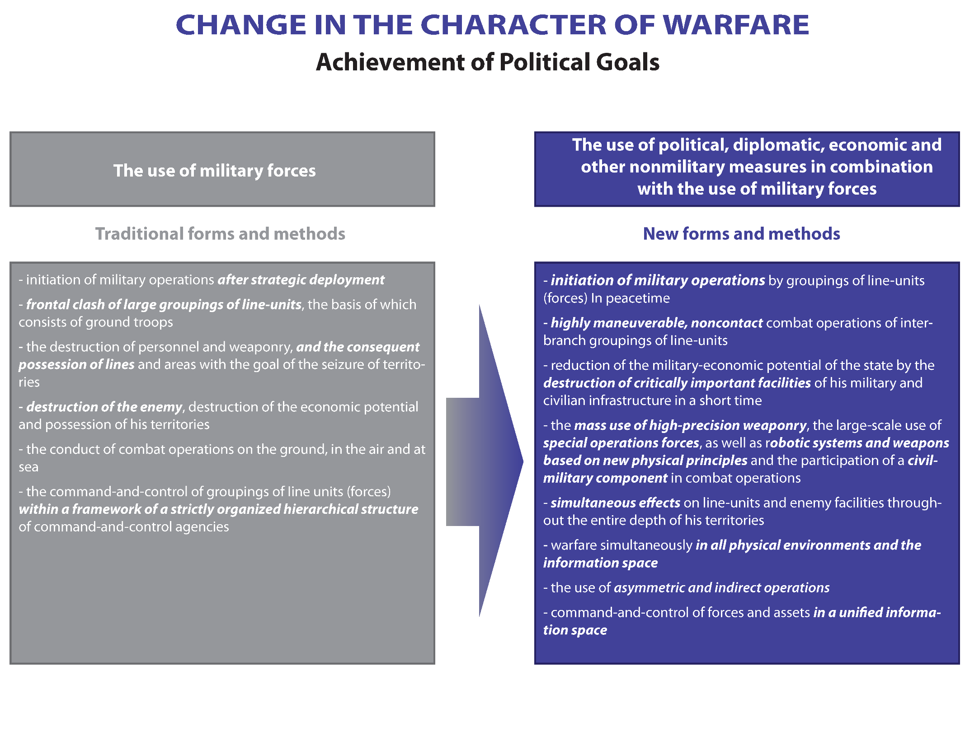
Notes:
General Valery Gerasimov, “The Value of Science Is in the Foresight: New Challenges Demand Rethinking the Forms and Methods of Carrying out Combat Operations,“ Voyenno-Promyshlennyy
Kurier online, 26 February 2013, http://vpk-news.ru/articles/14632.

Slide 11
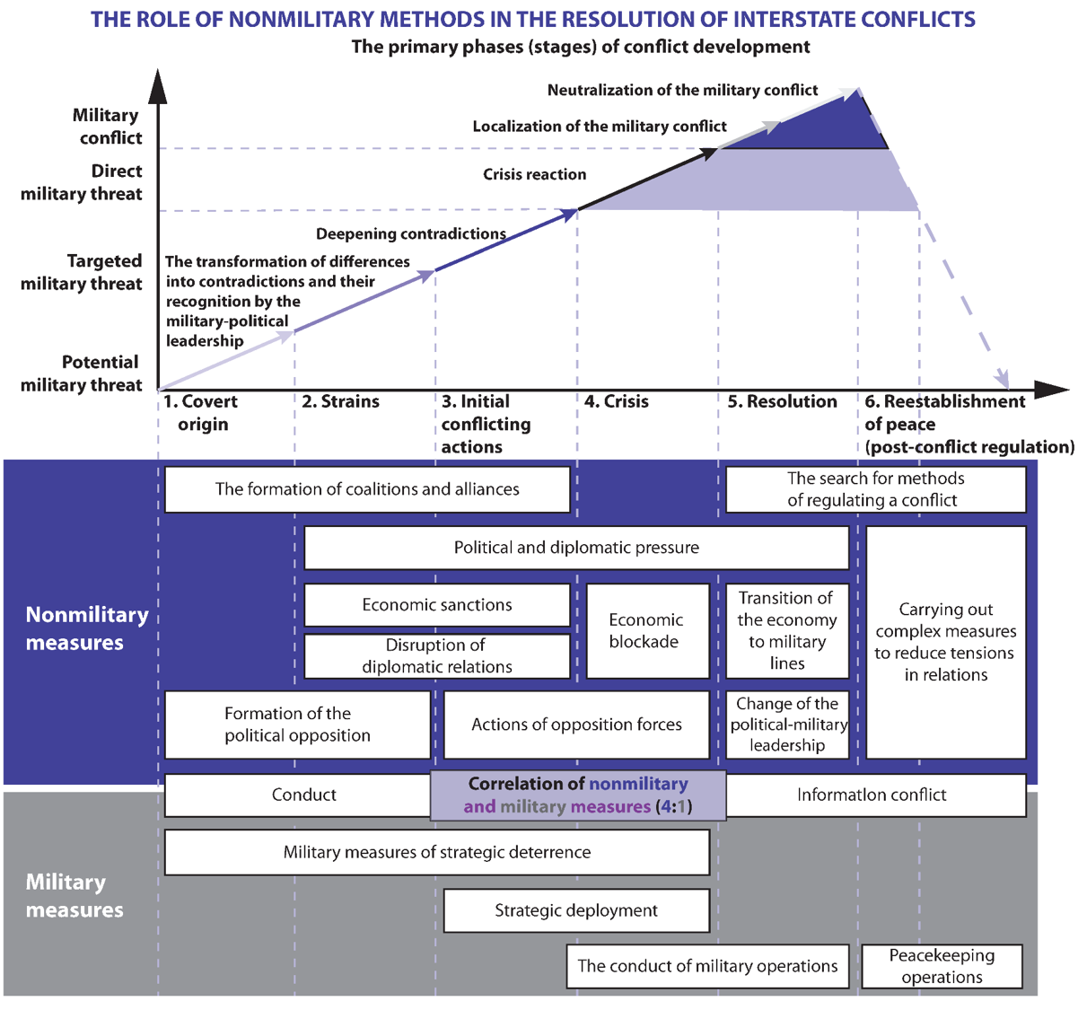
Notes:
General Valery Gerasimov, “The Value of Science Is in the Foresight: New Challenges Demand Rethinking the Forms and Methods of Carrying out Combat Operations,“ Voyenno-Promyshlennyy
Kurier online, 26 February 2013, http://vpk-news.ru/articles/14632.

Slide 12
Gerasimov’s Article: Dialectic & Phases?
Be very careful with the previous graphic
Intended to be illustrative, not predictive
Graphic shows evidence of dialectical thinking, not as conducive to our ‘neat’ phases
…So what does Gerasimov say about models in his article?

Slide 13
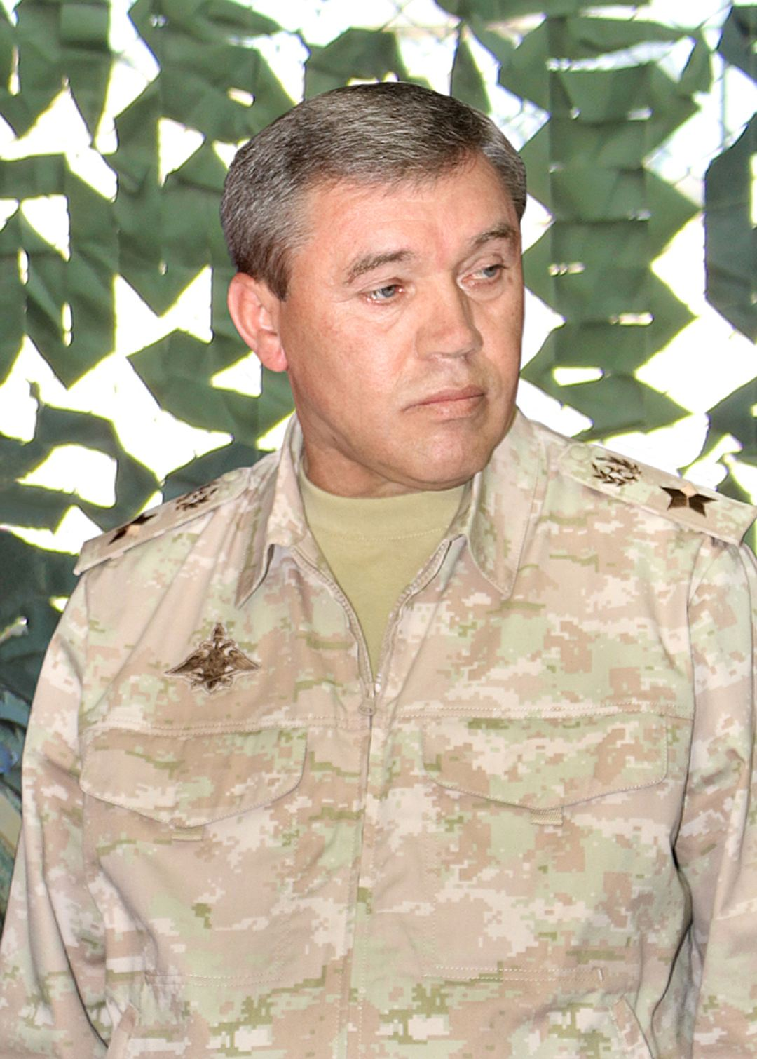
Gerasimov’s Article: What about Models?
The renowned Soviet military academician Aleksander Svechin wrote: "It is unusually difficult to foresee the circumstances of a war . . . It is necessary to work out a particular line of strategic conduct for each war, and each war represents a partial case, requiring the establishment of its own peculiar logic, and not the application of some sort of model.”
- General Gerasimov
Notes:
The renowned Soviet military academician Aleksandr Svechin wrote: "It is unusually difficult to foresee the circumstances of a war . . . It is necessary to work out a particular line of strategic conduct for each war, and each war represents a partial case, requiring the establishment of its own peculiar logic, and not the application of some sort of model."

Slide 14
Gerasimov’s Article: Conclusions
Gerasimov/General Staff do not do strategy, they do operational art & force development
He is describing the Operational Environment
Not much ‘new’, just asking the Academy of Sciences to look into the topic
Primarily interested in U.S. role in fomenting Color Revolutions and the Arab Spring, and ensuring it does not happen in Russia
Probably messaging to leadership

Slide 15
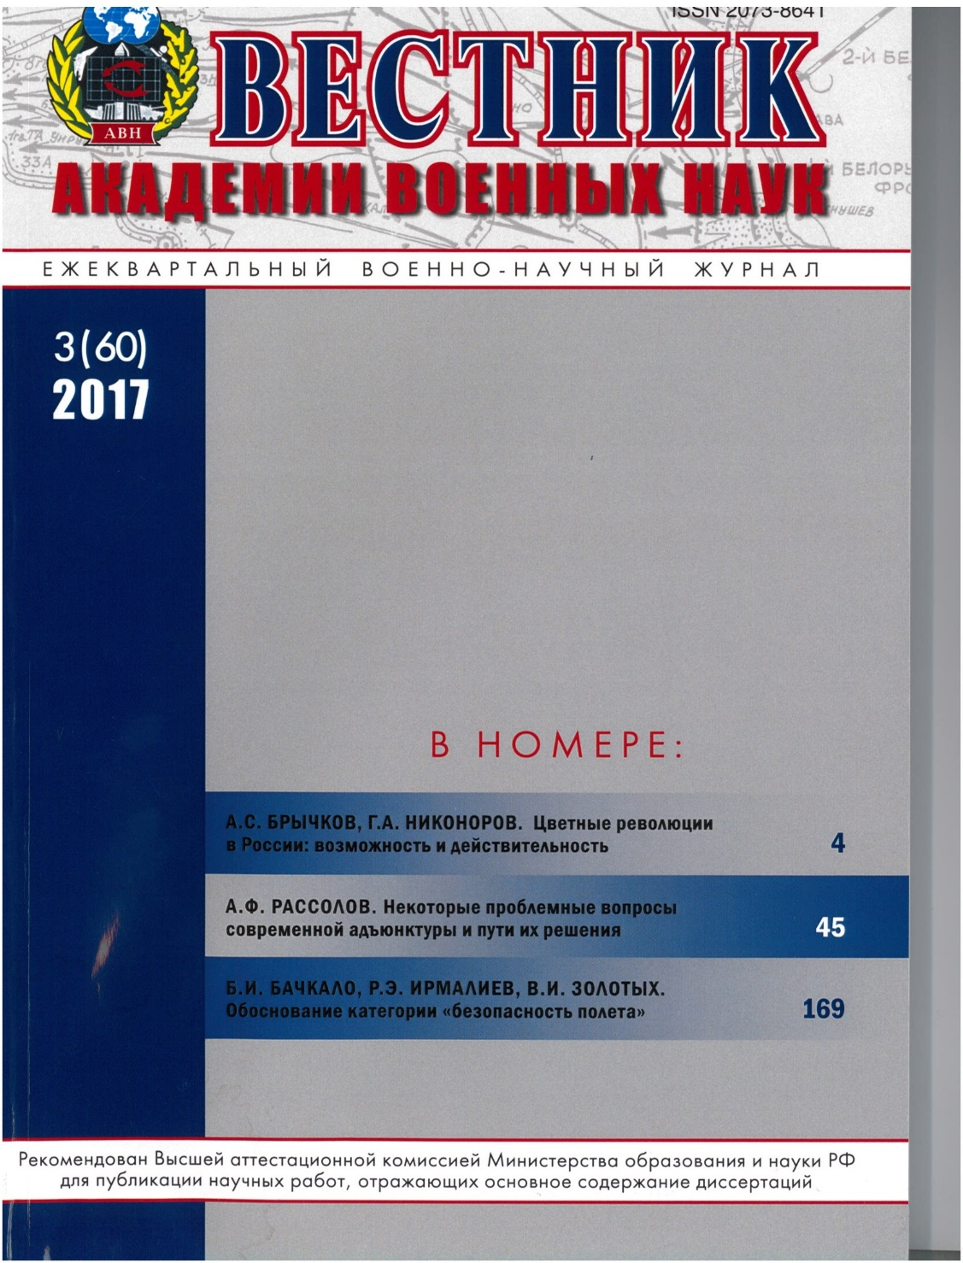
Gerasimov’s Article: Still A Concern?
Journal of The Academy of Military Sciences
Color Revolutions in Russia: Possibility and Reality
Abstract
This paper presents analysis of the political regime transformation technology known as “color revolutions.” The reasons, mechanisms and consequences of nationhood destruction are considered. Special attention is given to the U.S.’s role in the artificial creating of cataclysms designed to harm the security of single states and whole regions.

Slide 16
Syrian Campaign: Russian Narrative
Caused due to Arab Spring, which was caused by primarily U.S. State Dept funded Info operations (social media, mass media) and NGOs
European Syrian refugee crisis direct result of U.S. sponsored Arab Spring
After insurrection started in Syria, U.S./West decision made to topple regime
SOF, covert operations, arms, and training
Government response provides pretext for sanctions and direct military intervention
Only through Russian intervention, regime survived

Slide 17
Syrian Campaign: Gerasimov’s ‘Model’?
Gerasimov did not intend for the graphic to be used as a model…but it does work with Syria
Syria probably in mind when article drafted
Theory intended to explain new ways of toppling regimes (Color Revolutions/Arab Spring), not how to counter such activities
Fits Syria very well, also Russian actions regarding Ukraine
So, how might General Gerasimov see it???

Slide 18
Russian Perspective
1- U.S./West sponsored media and NGOs
2- Creating/Supporting anti-Assad opposition
3- Creation of European anti-Assad alliance
4- Movement of forces in VIC Syria to deter
5- UN resolution, diplomatic démarches
6- 2012 EU sanctions on Assad family and other personnel
7- Withdrawal of ambassadors, diplomatic isolation
8- Discussed, but never implemented
9- Opposition forces begin insurrection; introduction of SOF*
10- Alliance forces stage and prepare for operations
11- Airstrikes
12- ???
13- Has not occurred
14- Promoted by the Arab League, the UN Special Envoy on Syria, Russia, and Western Powers, but NSA
15- TBD
16-TBD
The
Gerasimov ‘model’ applied in Syria
3
14
5
16
6
8
7
12
2
9
13
1
4
10
11
15
Notes:
General Valery Gerasimov, “The Value of Science Is in the Foresight: New Challenges Demand Rethinking the Forms and Methods of Carrying out Combat Operations,“ Voyenno-Promyshlennyy
Kurier online, 26 February 2013, http://vpk-news.ru/articles/14632.

Slide 19
Syrian Campaign: Inverse Gerasimov?
Theory intended to describe the U.S./West new way of toppling regimes, but could it help defeating such efforts? (Maybe?)
Instead of looking at the U.S./West’s activities to destabilize regimes, would have to focus at counteractions to these activities.
Interesting how a third party (Russia) will fit into a theory that only envisioned the U.S./West and a beleaguered regime.
So, how could it look in Syria?

Slide 20
Russian Perspective
1- Russian mass/social media (RT/twitter/etc)
2- illegitimacy of opposition touted
3- Russia-Syrian alliance
4- Naval assets on coast; S-400 emplacements to
Prevent and create
‘No-Fly’ zones
5- Russian UN sponsored resolutions
6- Russia provides economic aid
7- Russia prevents complete diplomatic isolation of Assad
8- Russia prevents economic blockades
9- entry of advisors and private military companies*; Russia labels all opposition ‘ISIS’, tries to create pretext for acceptable use of violence
10- Russian deployment
11- Airstrikes; Mission creep- ground mission
12- ???
13- Has not occurred
14- Peace process favorable for Assad/Russia
(Astana talks)
15- TBD
16- TBD
The Inverse
Gerasimov ‘model’ applied in Syria
3
14
5
16
6
8
7
12
2
9
13
1
4
10
11
15
Notes:
General Valery Gerasimov, “The Value of Science Is in the Foresight: New Challenges Demand Rethinking the Forms and Methods of Carrying out Combat Operations,“ Voyenno-Promyshlennyy
Kurier online, 26 February 2013, http://vpk-news.ru/articles/14632.

Slide 21
Syrian Campaign: The Messaging
Shaping the narrative (IO) very important, not only to Syria, but allies and rest of world
Russia is in it for the long haul, and will not abandon its allies
U.S./West uses primarily SOF to topple, while Russia uses primarily conventional forces to support…Russia operates in plain view, while the U.S./West acts covertly
The U.S./West forces its liberal-democratic values on others, but Russia preserves traditional values.
Russian intervention model (supporting governments instead of toppling them) is more economical and sustainable

Slide 22
Your Questions, My Two Cents
What is the relationship between the ‘Gerasimov model’ and the Soviet Subversion Model, and how applicable is it to current Russian activities?
Different intents, for different users
  Gerasimov (MoD)- describing the OE
  Bezmenov (intel services & GRU)- insurgency
Is Gerasimov’s theory currently applicable?-Yes, but Gerasimov is asking the Academy of Military Sciences about how to combat Color Revolutions, and what next theory (or evolution of warfare) could look like.

Slide 23
Your Questions, My Two Cents
What Russian policy goals are directly related to Russian decision making in Syria?
Prevent radical Islam from spreading North
Preserve the Syrian Army (or whatever is left of it)
Maintain port facilities at Tartus
Demonstrate efficacy or Russian equipment and tactics for deterrence and export purposes
Show presence and building relationships in region
Security/stability is better than chaos/democracy
Build goodwill in the West (Ukraine)
Demonstrate that the U.S. meddles and causes instability, while Russia bring strength and stability

Slide 24
Your Questions, My Two Cents
How do the cultural aspects of the Russian Ministry of Defense, intelligence, and other militarized security services affect the Russian view of private military companies (PMCs)?
&
How do Russian corporations factor into Russian Government support to the Assad regime?
The Wagner PMC employs estimated 2,500 in Syria
Very contentious issue
GRU loves, FSB hates
Legally PMCs in limbo, legislation much discussed, but no progress
No resolution in sight
Notes:
The Wagner PMC is the informal name of the private military company led by Dmitriy Utkin, a retired lieutenant colonel and former commander of a unit in the 2nd GRU Spetsnaz Brigade. The Wagner PMC first became widely known in 2014, during the height of fighting in the Donbas, where it was actively engaged in fighting with the separatists against the Ukrainian government. Reports of Wagner being involved in the Syria campaign started to surface in October, 2015. Since then, Wagner was involved with the liberation of Palmyra and Aleppo from ISIS. Today, Wagner employs an estimated 6000 personnel, approximately 2,500 are currently working in Syria.
The Wagner PMC forces in Syria are organized into four reconnaissance and assault brigades, with each brigade having three companies, with each company having up to 100 personnel. In addition, there is an artillery battalion (three batteries, each with approximately 100 personnel); a tank company (50 personnel in three platoons, each with four tanks); a sabotage and reconnaissance company (about 150 personnel); a signal company (about 100 personnel); staff and support (about 200 personnel). Although there is no official relationship between the Russian government and the Wagner PMC, it is obvious that Wagner is at least Russian government supported, and likely at least partially funded. Wagner reportedly trains its personnel at the 10th Spetsnaz Brigade’s military training ranges and other facilities, are equipped from government depots, and are transported to Syria on Russian Navy vessels and military aircraft.
Although the Russian government appears to be a fan of PMCs, legislation fully legalizing their activities has not been forthcoming. Apparently, various interest groups in the security services have different ideas about the long-term security issues of legalizing military forces that are not directly controlled by the state. In general, intelligence organs such as the Main Intelligence Directorate of the General Staff (GRU) have championed the legalization of PMCs, while counterintelligence interests, such as the Federal Security Service (FSB), have opposed such legalization. Russia has already loosened some restrictions on privatized security forces. In 2005, Russia passed the federal law 154-FZ “On State Service of the Russian Cossacks,” to clarify the Cossacks’ legal status and allowing for them to form paramilitary units to fulfill limited law enforcement duties. But the sensitive nature of PMCs and desire of the Russian government to maintain a modicum of plausible deniability about their activities may keep the legal status of PMCs in limbo for the foreseeable future.

Slide 25
Your Questions, My Two Cents
How does Syria’s lack of a large ethnic Russian population affect Russian activities as compared to other Russian military interventions (like Moldova, Georgia, and Ukraine) which all had significant Russian ethnic populations?
Lots of Russians have married Syrians, (≈20,000) and stayed in Syria over the years. Many Russian citizens and their families have come to Syria to be with ISIS. Russian diaspora always a big concern in Russia.
Small Russian population, but a substantial Orthodox Christian population that is loyal to Assad.
Not really a major concern, no desire to foment a disaffected (Russian) minority…The Syrian Campaign is about supporting the regime, not building opposition in a particular minority group.
Notes:
The Wagner PMC is the informal name of the private military company led by Dmitriy Utkin, a retired lieutenant colonel and former commander of a unit in the 2nd GRU Spetsnaz Brigade. The Wagner PMC first became widely known in 2014, during the height of fighting in the Donbas, where it was actively engaged in fighting with the separatists against the Ukrainian government. Reports of Wagner being involved in the Syria campaign started to surface in October, 2015. Since then, Wagner was involved with the liberation of Palmyra and Aleppo from ISIS. Today, Wagner employs an estimated 6000 personnel, approximately 2,500 are currently working in Syria.
The Wagner PMC forces in Syria are organized into four reconnaissance and assault brigades, with each brigade having three companies, with each company having up to 100 personnel. In addition, there is an artillery battalion (three batteries, each with approximately 100 personnel); a tank company (50 personnel in three platoons, each with four tanks); a sabotage and reconnaissance company (about 150 personnel); a signal company (about 100 personnel); staff and support (about 200 personnel). Although there is no official relationship between the Russian government and the Wagner PMC, it is obvious that Wagner is at least Russian government supported, and likely at least partially funded. Wagner reportedly trains its personnel at the 10th Spetsnaz Brigade’s military training ranges and other facilities, are equipped from government depots, and are transported to Syria on Russian Navy vessels and military aircraft.
Although the Russian government appears to be a fan of PMCs, legislation fully legalizing their activities has not been forthcoming. Apparently, various interest groups in the security services have different ideas about the long-term security issues of legalizing military forces that are not directly controlled by the state. In general, intelligence organs such as the Main Intelligence Directorate of the General Staff (GRU) have championed the legalization of PMCs, while counterintelligence interests, such as the Federal Security Service (FSB), have opposed such legalization. Russia has already loosened some restrictions on privatized security forces. In 2005, Russia passed the federal law 154-FZ “On State Service of the Russian Cossacks,” to clarify the Cossacks’ legal status and allowing for them to form paramilitary units to fulfill limited law enforcement duties. But the sensitive nature of PMCs and desire of the Russian government to maintain a modicum of plausible deniability about their activities may keep the legal status of PMCs in limbo for the foreseeable future.

Slide 26
Closing Thoughts/My Opinion………..
The Russians conspiratorial view of U.S. democracy building activities is the impetus for the Arab Spring/Color revolutions narrative.
Don’t get too hung up on General Gerasimov, his crystal ball is as cloudy as yours…
Gerasimov/The General Staff did not conceive of the intervention, it was a strategic decision made at higher levels (NSC).
Although there were likely on-shelf contingencies, doesn’t look like there was much time between decision to enter and deployment.
Assad is a lesser evil than ISIS.
Russia has a lot more to lose/gain in Syria than we do.
Russia has took initiative, entered the Syrian conflict, fought ISIS, and saved Assad’s regime. These facts have increased Moscow’s prestige. Aside from human rights concerns, this is not necessarily a bad thing.

Slide 27
Вопросы?
Foreign Military Studies Office
Fort Leavenworth, Kansas
Chuck Bartles
charles.k.bartles.civ@mail.mil

Slide 28
Back-Up Slides

Slide 29
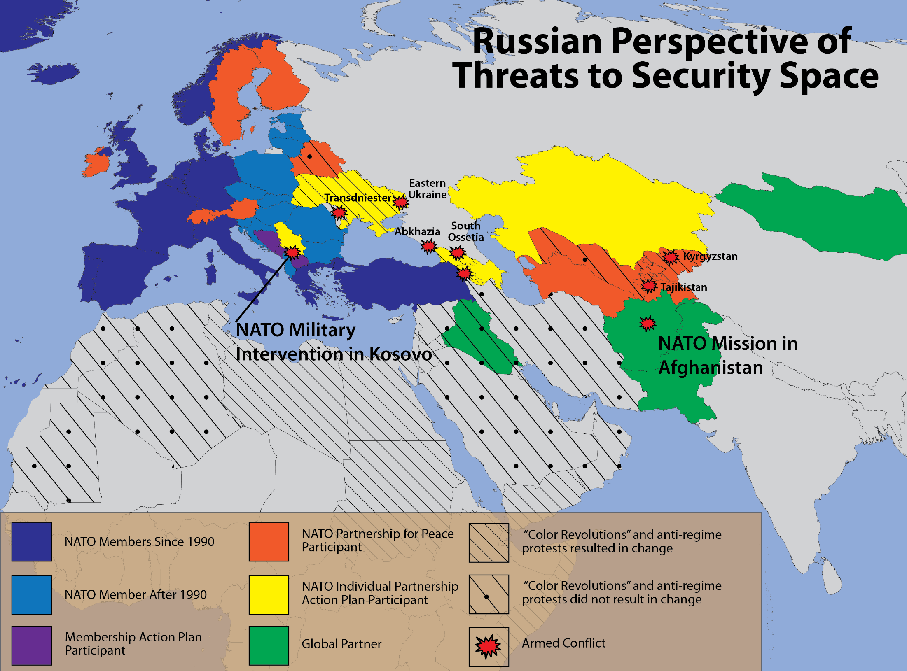
Notes:
Dr. Anthony H. Cordesman attended the Russian Ministry of Defense’s third Moscow Conference on International Security on 23 May 2014. While in attendance, Cordesman was able to take pictures of Gen. Valery Gerasimov’s slide presentation. A few of the presentation’s key slides (figures 1, 2, and 3) have been substantially recreated to accompany this article. Cordesman later produced a report on the conference that includes a broader selection of not only the slides presented by Gerasimov, but a selection of materials presented by other participants. The report is titled “A Russian Military View of a World Destabilized by the US and the West.” It may be viewed in its entirety at the Center for Strategic & International Studies website, accessed 20 November 2015, http://csis.org/publication/russia-and-color-revolution.

Slide 30
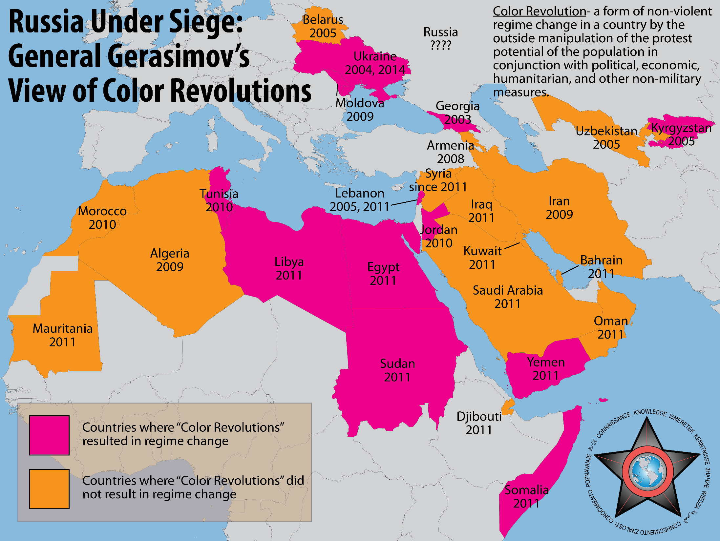
Notes:
Dr. Anthony H. Cordesman attended the Russian Ministry of Defense’s third Moscow Conference on International Security on 23 May 2014. While in attendance, Cordesman was able to take pictures of Gen. Valery Gerasimov’s slide presentation. A few of the presentation’s key slides (figures 1, 2, and 3) have been substantially recreated to accompany this article. Cordesman later produced a report on the conference that includes a broader selection of not only the slides presented by Gerasimov, but a selection of materials presented by other participants. The report is titled “A Russian Military View of a World Destabilized by the US and the West.” It may be viewed in its entirety at the Center for Strategic & International Studies website, accessed 20 November 2015, http://csis.org/publication/russia-and-color-revolution.

Slide 31
It’s Valery Gerasimov’s fault
The first person to blame for this mess is Russia’s chief of General Staff, Valery Gerasimov, and his oft-cited article in VPK, published in late February 2013 with the title “The Value of Science in Prediction,” outlining what he calls “non-linear warfare.” To be more precise, the problem was not his article, but the interpretation of it in Western circles. That publication did more damage to Western analysis of Russian military thought than any deception operation could. It was presumed to be a blueprint of Russian military thinking and doctrine, a “Gerasimov Doctrine” if you will (which is what some literally call it). Not only has it been overly convenient to believe that after barely a few months on the job Gerasimov wrote the Rosetta Stone for Russian military thinking, but even more puzzling is the idea that within a year the Russian General Staff had moved this collection of observations off PowerPoint and into a brilliant hybrid warfare campaign in Ukraine.
RUSSIAN HYBRID WARFARE AND OTHER DARK ARTS
MICHAEL KOFMAN
https://warontherocks.com/2016/03/russian-hybrid-warfare-and-other-dark-arts/

Slide 32
Russia and the “Color Revolution”
A Russian Military View of a World Destabilized by the US and the West
https://www.csis.org/analysis/russia-and-%E2%80%9Ccolor-revolution%E2%80%9D

